Slide 1


FIRST QUARTER 2026
ANALYST AND INVESTOR BRIEFING
April 28, 2026

Slide 2

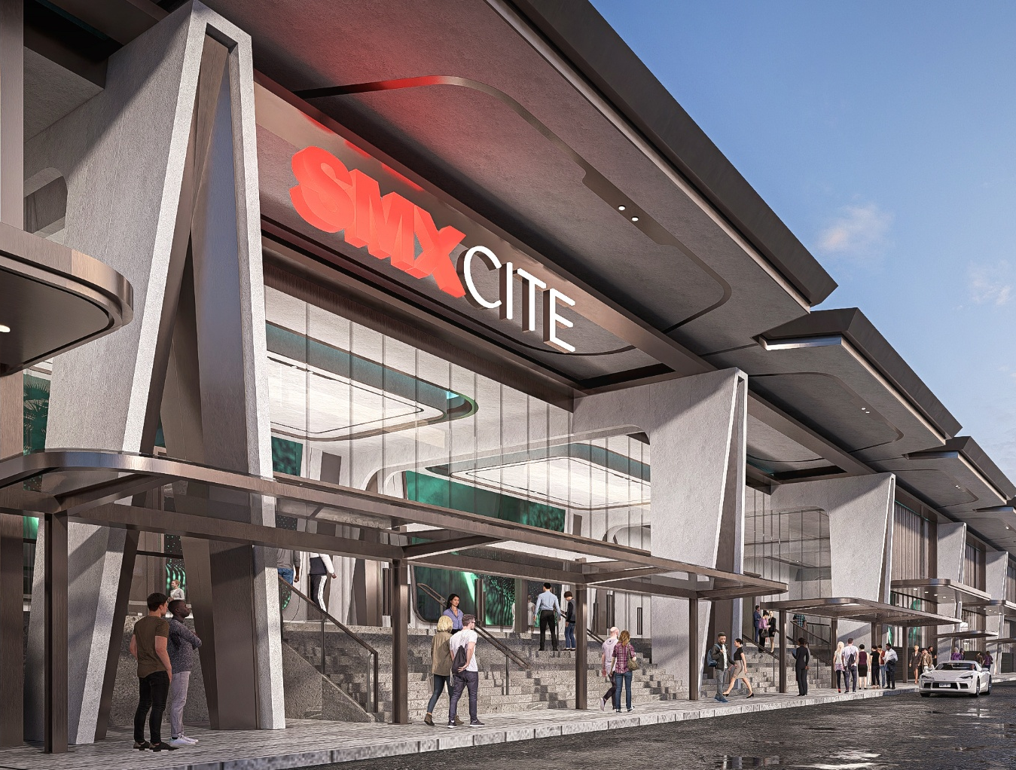
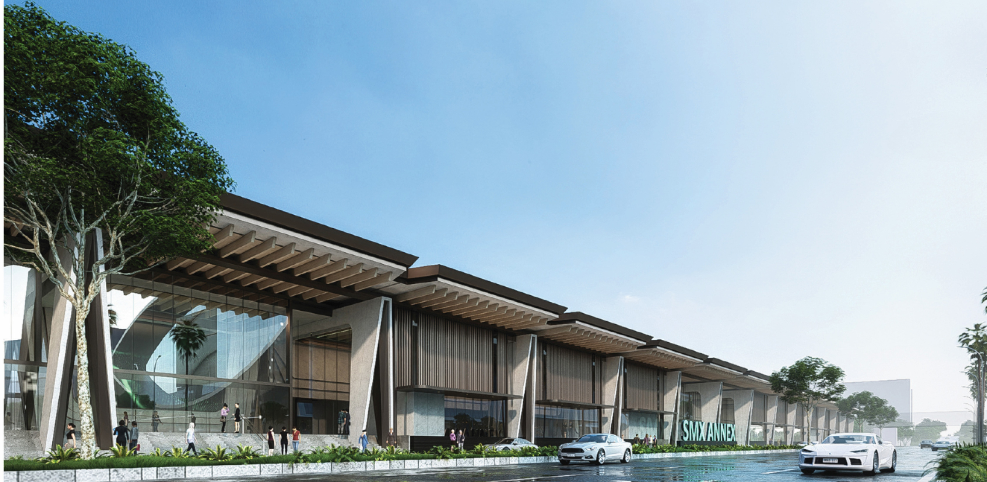
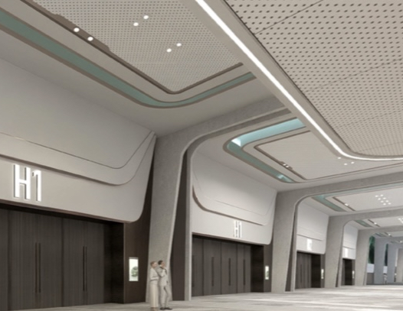
FEATURED PROPERTY
SMXCITE
Located within the SM Mall of Asia Complex, the SMX Center for International Trade and Exhibitions (SMXCITE) has over 18,000 square meters of leasable space. It features five exhibition halls accommodating up to 803 standard 3x3-meter booths, four meeting rooms and two VIP lounges for over 18,000 guests.
2

Slide 3

DISCLAIMER
This presentation does not constitute a prospectus or other offering memorandum in whole or in part. This presentation does not constitute an offer to sell or the solicitation of an offer to buy any securities of the Company. There shall be no sale of these securities in any state or jurisdiction in which such offer, solicitation or sale would be unlawful prior to any qualification under the securities laws of such state or jurisdiction. This presentation has not been and will not be reviewed or approved by any statutory or regulatory authority or any stock exchange in the Philippines or elsewhere. Prospective investors should undertake their own assessment with regard to their investment, and they should obtain independent advice on any such investment’s suitability, inherent risks and merits and any tax, legal and accounting implications which it may have for them.
This presentation contains statements about future events and expectations that constitute “forward-looking statements.” These forward-looking statements include words or phrases such as the Company or its management “believes”, “expects”, “anticipates”, “intends”, “may”, “plans”, “foresees”, “targets”, “aims” “would”, “could” or other words or phrases of similar import. Similarly, statements that describe the Company's objectives, plans or goals are also forward-looking statements. All such forward-looking statements are subject to known and unknown risks and uncertainties that could cause actual results to differ materially from those contemplated by the relevant forward-looking statement. Such forward-looking statements are made based on management’s current expectations or beliefs as well as assumptions made by, and information currently available to, management. These forward-looking statements speak only as at the date of this presentation, and nothing contained in this presentation is or should be relied upon as a promise or representation as to the future.
This presentation and the contents hereof are for the exclusive use of the intended recipient(s). This presentation and the contents hereof should not be (i) forwarded or delivered or transmitted in any manner whatsoever, to any other person other than the intended recipient(s); or (ii) reproduced in any manner whatsoever. Any forwarding, distribution or reproduction of this presentation in whole or in part is unauthorized. This presentation must not be distributed to the press or any media organization. By accepting this presentation, the recipient agrees to keep confidential at all times information contained in or made available in connection with this presentation.
Neither the Company nor its advisor, nor any of their respective affiliates, shareholders, directors, employees, agents or advisers makes any expressed or implied representations or warranties as to the accuracy and completeness of the information contained herein or any other information (whether communicated in written or oral form) and each of the foregoing parties expressly disclaims any and all responsibility and liability of any kind (including any contractual, non-contractual, or third party liability) for any loss or damage, whether or not arising from any error or omission in compiling such information or as a result of any party’s reliance or use of such information. The information in this presentation has not been independently verified. The information and opinions in this presentation are subject to change without notice, and no obligation is assumed by the Company nor its advisor, nor any of their respective affiliates, shareholders, directors, employees, agents or advisers to provide the recipient(s) with access to any additional information or to update this presentation or to correct any inaccuracies in it which may become apparent.
3

Slide 4

OVERVIEW
HIGHLIGHTS
05
10
OUTLINE
SEGMENTS
UPDATES
OUTLOOK
15
19
21
4

Slide 5

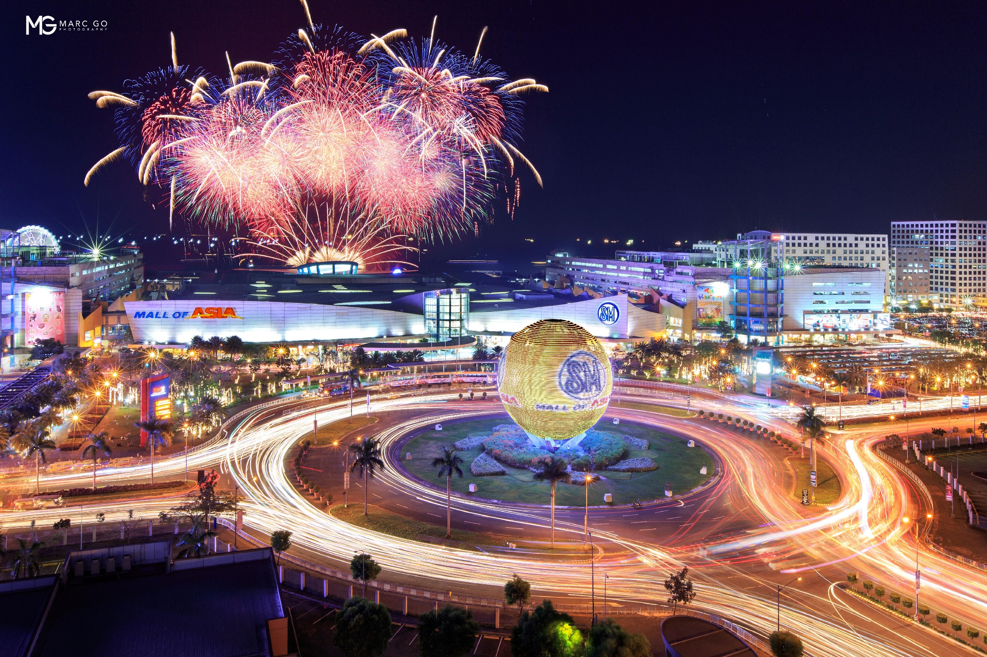
OVERVIEW
We are the largest integrated property developer in the Philippines, with a strategic presence in China. Our diversified and synergistic portfolio positions us strongly
for sustained growth and value creation.
P588B
MARKET CAPITALIZATION
P1,111B
CONSOLIDATED ASSETS
P475B
TOTAL EQUITY
All figures as of end of 1Q 2026
5

Slide 6
THE PRIME ADVANTAGE
Strong brand equity and strong balance sheet
MARKET LEADERSHIP
MULTI-BRAND STRENGTH
Largest network of malls, mid- market residential developments, MICE venues and cinemas
Market-leading and premium brands across key property sectors
RESILIENT EARNINGS
STRATEGIC EXPANSION
  65% of 1Q 2026 revenues from rentals
  P377B+ capex over 5 years
  P679B in investment properties
STRONG FISCAL DISCIPLINE
GREEN PROPERTIES
  6.28x interest coverage
  Net D/E ratio at 45:55
  60% of energy from renewables
  LEED-certified buildings
All figures as of end of 1Q 2026
6
Notes:
Insert SR Report

Slide 7
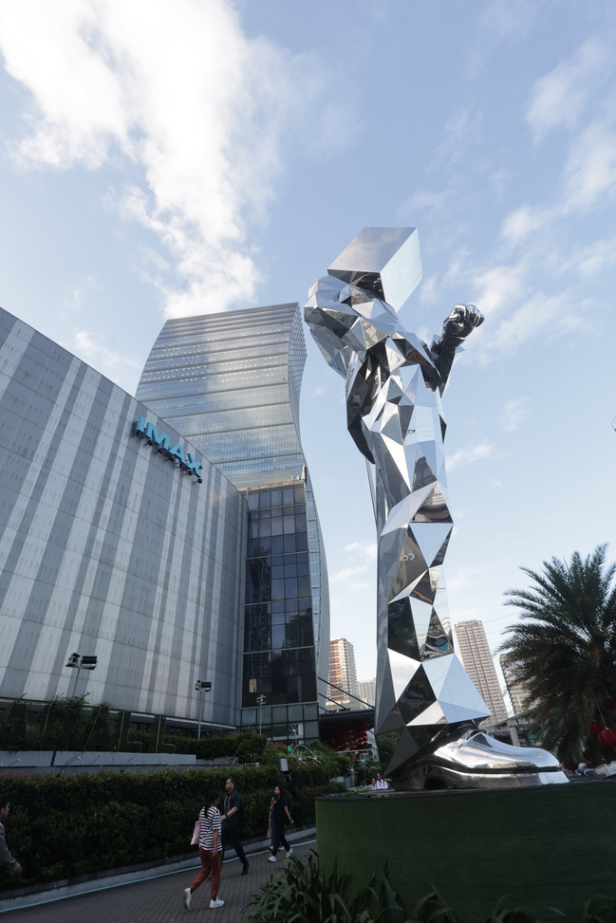
OUR PORTFOLIO
All figures as of end of 1Q 2026
Our diverse portfolio includes iconic shopping malls, modern residences, prime office spaces, premium hotels and world-class convention centers, creating thriving communities across the Philippines and in select cities in China.
22 | Integrated Property Developments
99 | Malls (Philippines and China)
379 | Cinema Screens
04 | Amusement Parks
68 | Residential Projects
25 | Leisure Projects
23 | Office Towers
06 | Warehouses
10 | Hotels
06 | Convention Centers
02 | Trade Halls
01 | Arena
4
7

Slide 8
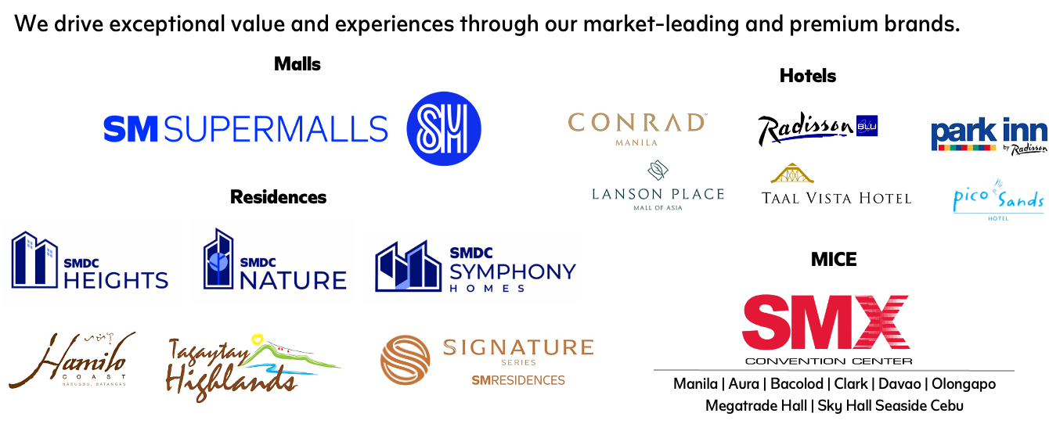
OUR BRANDS
We drive exceptional value and experiences through our market-leading and premium brands.
4
8

Slide 9
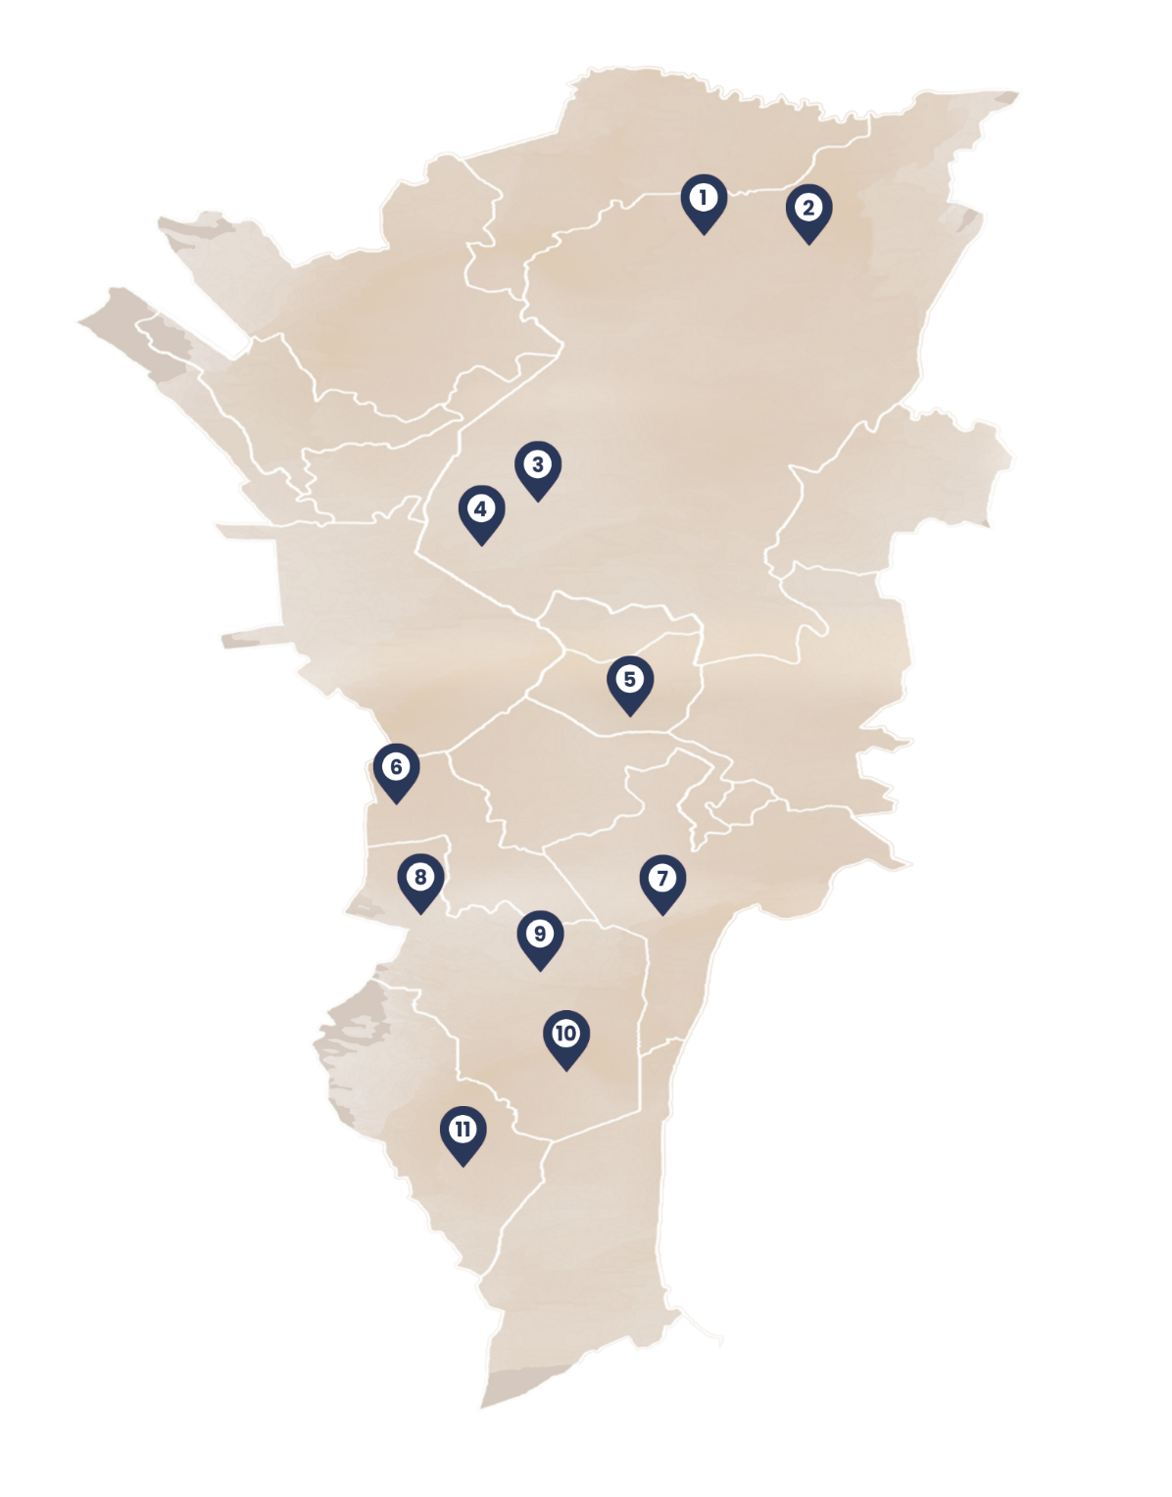
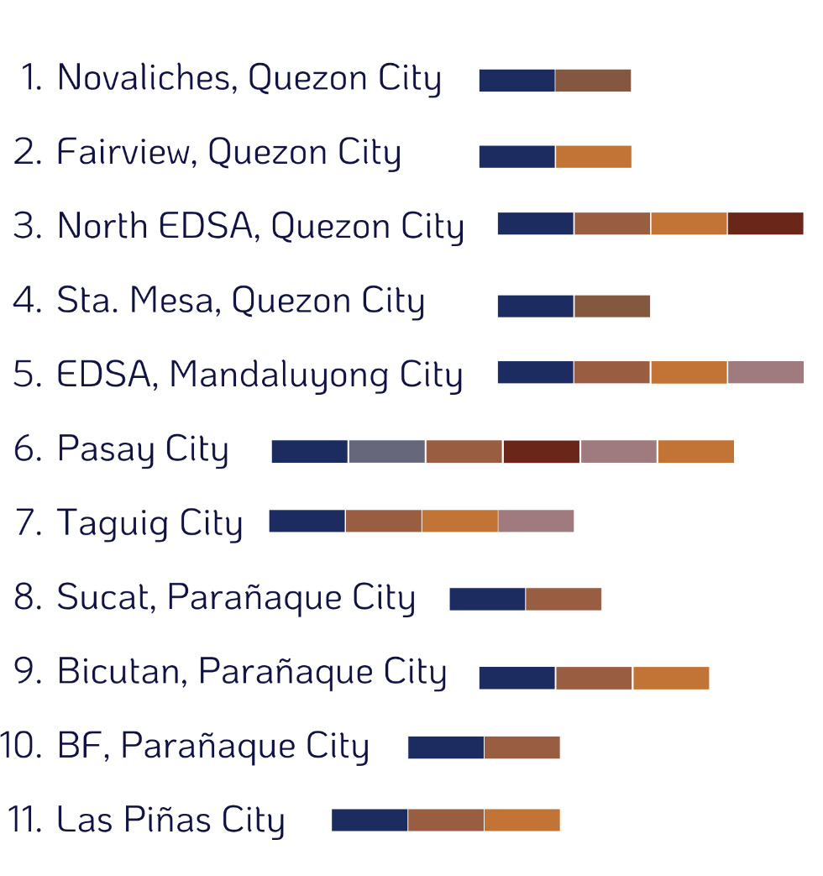
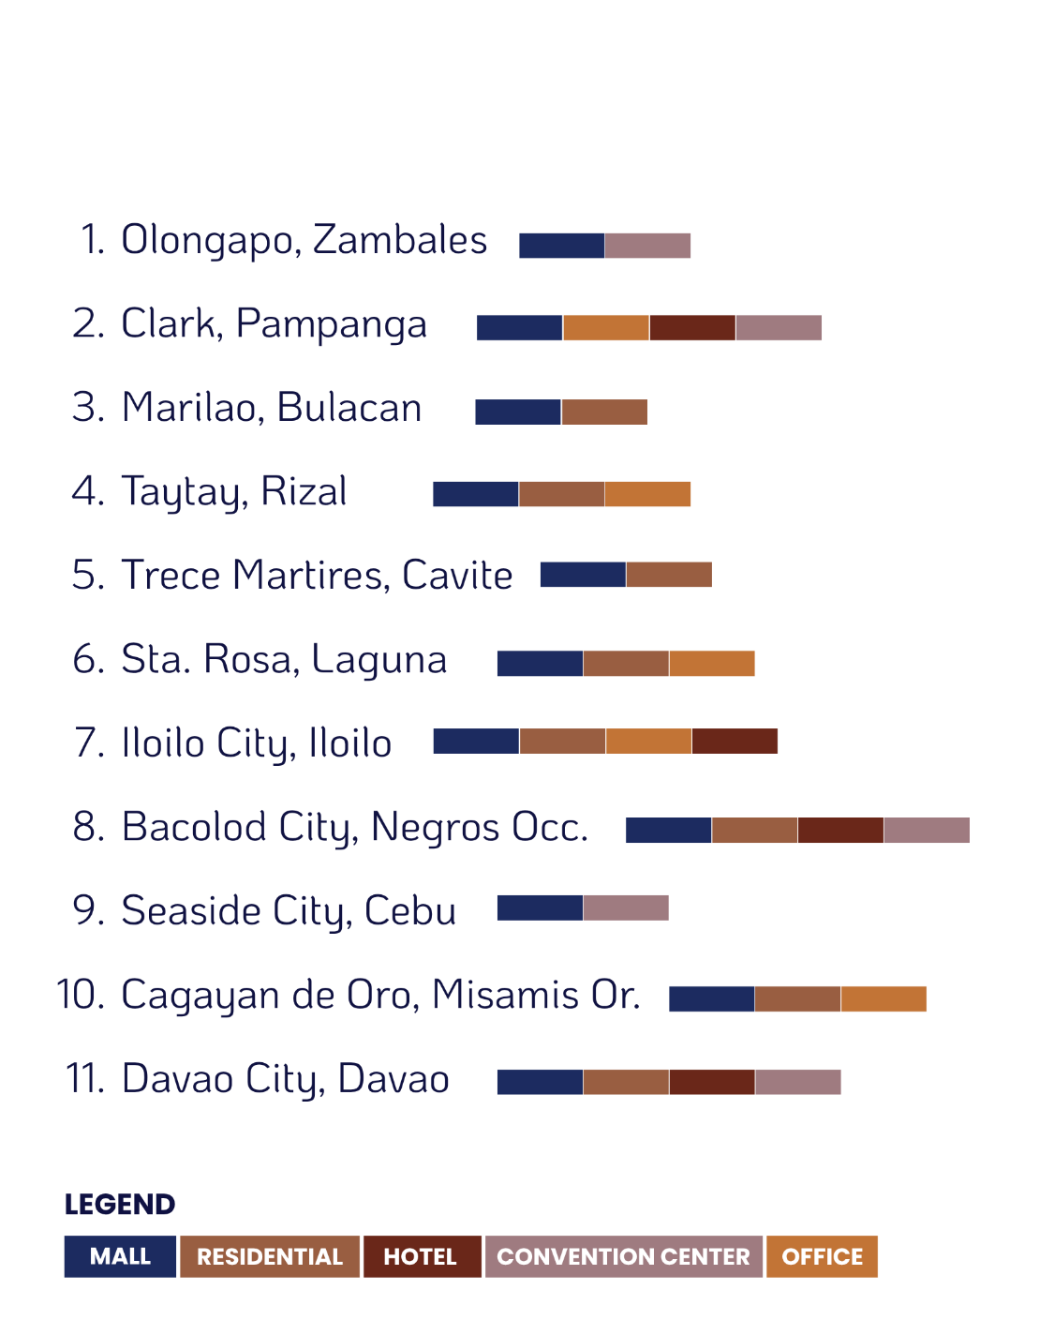

INTEGRATED PROPERTY DEVELOPMENTS
11
ONCR
11
NCR
4
9

Slide 10
CONSOLIDATED HIGHLIGHTS
In Php bn, except margin | 1Q 2026 | 1Q 2025 | % CHANGE
Revenue | 33.3 | 32.8 | 2%
EBIT | 16.7 | 16.7 | 0%
Net Income | 11.7 | 11.7 | 0%
EBITDA Margin | 62% | 62% | 0 pp
CAPEX | 15.5 | 17.1 | -9%
  Top line grew due to higher rental income and other revenues, which helped cushion weaker real estate sales.
  Rental income jumped due to higher mall and office occupancy, along with higher ticket sales, food and beverage revenue, and stronger uptake of experiential offerings.
  Net income unchanged as costs and expenses outpaced revenue growth.
4
10
9

Slide 11
KEY FINANCIAL RESULTS
In Php mn | 1Q 2026 | 1Q 2025 | % CHANGE
Revenue | 33,279 | 32,773 | 2%
Cost and Expenses | 16,552 | 16,095 | 3%
Operating Income | 16,727 | 16,679 | 0%
Net Income Attributable to Parent | 11,661 | 11,653 | 0%
EBITDA | 20,588 | 20,233 | 2%
See Appendix for further details
4
11
9

Slide 12
REVENUE BREAKDOWN
Rent contributed 65% of total revenues, up from 61% a year ago
In Php mn | 1Q 2026 | 1Q 2025 | % CHANGE
Rent | 21,611 | 20,021 | 8%
Real Estate Sales | 7,757 | 9,217 | -16%
Others* | 3,912 | 3,536 | 11%
Total Revenue | 33,279 | 32,773 | 2%
1Q 2026
P33.3B
1Q 2025
P32.8B
*Others include revenues from ice skating, bowling, amusement and recreation, hotel F&B sales, sponsorships, advertising, and cinema and event ticket sales
4
12
9

Slide 13
CAPITAL STRUCTURE
Asset growth is well-supported by disciplined balance sheet management, with healthy liquidity and strategically managed debt.
ASSET GROWTH
LIQUIDITY POSITION
DEBT AND LEVERAGE
P1,110.9B
P19.9B
P426.1B
TOTAL ASSETS
OPERATING CASH FLOW
INTEREST-BEARING DEBT
P679.3B
P35.4B
P632.6B
INVESTMENT PROPERTIES
CASH AND CASH EQUIVALENTS
TOTAL LIABILITIES
P182.1B
P220.9B
45:55
REAL ESTATE INVENTORY
TOTAL CURRENT ASSETS
NET DEBT-TO-EQUITY RATIO
4
13
9

Slide 14
STRONG BALANCE SHEET AND PRUDENT CAPITAL MANAGEMENT
Healthy balance sheet and careful cash flow management, backed by disciplined investment assessment on land banking and project developments
(1)
(2)
YR 5: 67.3
(x)
(PHP bn)
YR 4: 84.2
YR 3: 55.5
YR 2: 47.2
(1)
(x)
(x)
31-Dec-22
31-Dec-23
31-Dec-24
31-Dec-25
31-Mar-26
*(1)Net debt refers to total interest-bearing debt less cash and cash equivalents; (2) Refers to long-term debt less debt issue cost
4
14
9

Slide 15
REVENUE CONTRIBUTION PER SEGMENT
In Php mn | 1Q 2026 | 1Q 2025 | % CHANGE
Malls | 20,391 | 18,866 | 8%
Residences | 8,303 | 9,697 | -14%
Hotels and CC | 2,187 | 2,029 | 8%
Offices | 2,472 | 2,248 | 10%
Total Revenue | 33,279 | 32,773 | 2%
  Malls remained the largest contributor, accounting for 61% of total revenue.
  Residential followed representing 25% of total revenue.
  Hotels and Convention Centers and Offices represent the remaining of the total revenue.
4
15
9

Slide 16
MALLS
In Php mn | 1Q 2026 | 1Q 2025 | % CHANGE
Revenue | 20,391 | 18,866 | 8%
PH Malls Rental Income | 15,264 | 14,223 | 7%
Others | 5,127 | 4,642 | 10%
EBIT | 11,919 | 10,695 | 11%
EBITDA | 15,008 | 13,536 | 11%
For PH malls only | 1Q 2026 | 1Q 2025 | % CHANGE
Total GFA (in mn sqm) | 9.8 | 9.5 | 3%
Total GLA (in mn sqm) | 5.1 | 5.0 | 3%
Occupancy Rate (long-term) | 96% | 95% | 1pp
Occupancy Rate (short-term) | 92% | 93% | -1pp
Number of Tenants | 22,707 | 22,036 | 3%
Ave. Daily Foot Traffic (in mn) | 3.7 | 3.7 | 0%
YTD Foot Traffic (in mn) | 333.4 | 334.0 | 0%
*Mall-adjacent office rental income is reported under Office business segment.
SM MALL NETWORK
4
16
9

Slide 17
RESIDENCES
In Php mn | 1Q 2026 | 1Q 2025 | % CHANGE
Real estate sales, rentals and other revenues | 8,303 | 9,697 | -14%
EBIT | 2,513 | 3,959 | -37%
EBITDA | 2,593 | 4,024 | -36%
CORE AND LEISURE | 1Q 2026 | 1Q 2025 | % CHANGE
Reservation Sales (in Php mn) | 12,311 | 12,230 | 1%
Core | 11,946 | 11,644 | 3%
Leisure | 365 | 586 | -38%
Inventory (in units) | 28,317 | 24,779 | 14%
Inventory sales value (in Php bn) | 182,091 | 154,736 | 18%
1Q 2026 RESERVATION SALES (in %)
BY PRODUCT
CORE BY LOCATION
CORE BUYERS
CORE BUYERS
4
17
9

Slide 18
HOTELS AND CONVENTION CENTERS
In Php mn | 1Q 2026 | 1Q 2025 | % CHANGE
Revenue | 2,187 | 2,029 | 8%
EBIT | 504 | 433 | 16%
EBITDA | 718 | 632 | 14%
HOTELS | 1Q 2026 | 1Q 2025 | % CHANGE
Room Keys | 2,602 | 2,602 | 0%
Occupancy Rate | 67% | 66% | 1pp
Average Daily Rate | 6,274 | 5,854 | 7%
REVENUE BREAKDOWN
CONVENTION CENTERS | 1Q 2026 | 1Q 2025 | % CHANGE
GLA (in sqm) | 41,940 | 41,940 | 0%
Occupancy Rate | 47% | 43% | 4pp
Visitors | 1,766,088 | 1,495,669 | 18%
1Q 2025
1Q 2026
4
18
9

Slide 19
3PO 55
STANDALONE OFFICES 07
MALL-ADJACENT OFFICES 15
WAREHOUSES
05
Office Tenant Mix (in %)
Developments
OFFICES
(In Php mn) | 1Q 2026 | 1Q 2025 | % CHANGE
Revenue | 2,472 | 2,248 | 10%
EBIT | 1,790 | 1,592 | 12%
EBITDA | 2,269 | 2,041 | 11%
OFFICES | 1Q 2026 | 1Q 2025 | % CHANGE
GFA (in mn sqm) | 1.6 | 1.6 | 5%
GLA (in mn sqm) | 0.9 | 0.8 | 3%
Occupancy Rate | 77% | 70% | 7pp
DEVELOPMENTS
TENANT MIX (in %)
*Figures reported include all offices under SM Prime.
4
19
9

Slide 20
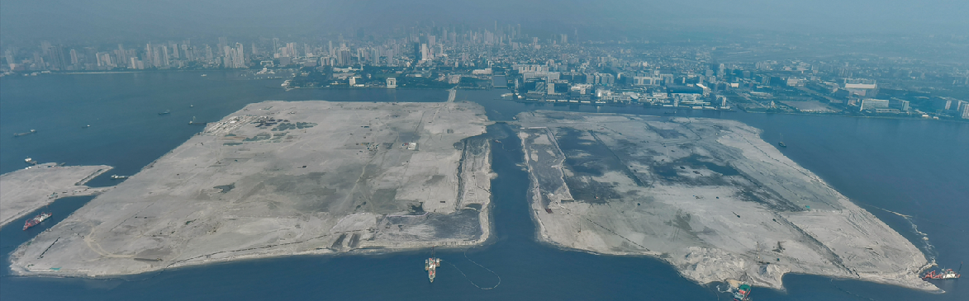
3PO 55
STANDALONE OFFICES 07
MALL-ADJACENT OFFICES 15
WAREHOUSES
05
Office Tenant Mix (in %)
Developments
PASAY 360
100% done
90%
done
ongoing
ongoing
on track
SM Prime’s most transformative integrated property development—an unprecedented urban estate that fuses connectivity, sustainability, livability, tourism and commerce.
Land Filling and Formation
Soil Stabilization Revetment Works and Ground Improvement
Infrastructure Planning and Development
Land
Titling
Project Turnover
4
20
9

Slide 21
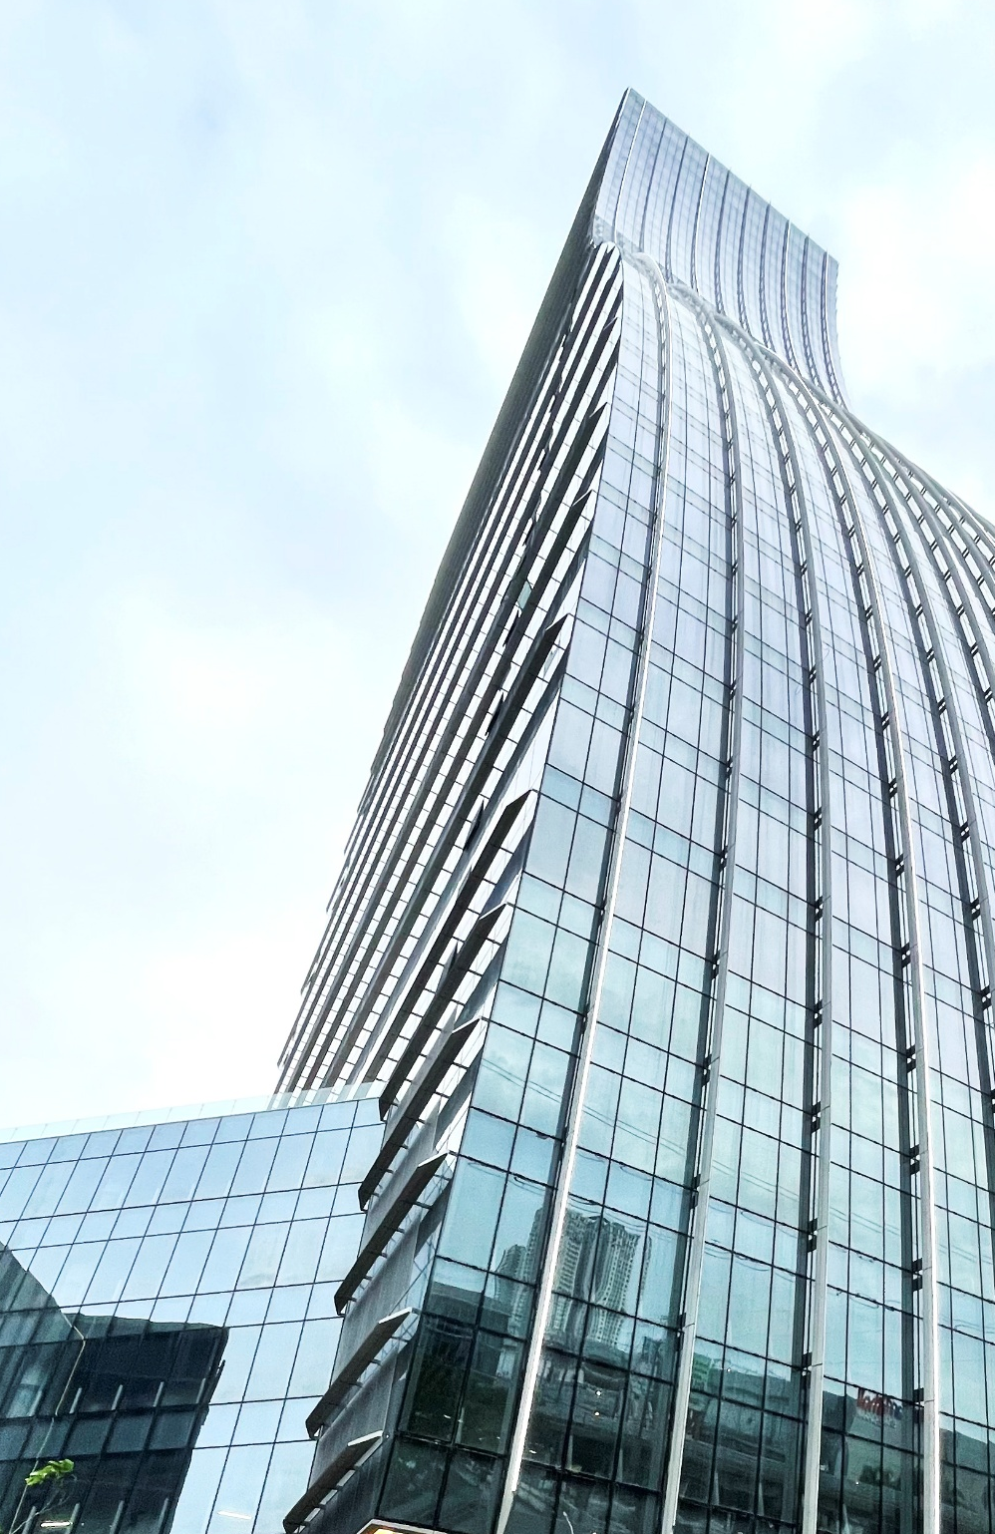
3PO 55
STANDALONE OFFICES 07
MALL-ADJACENT OFFICES 15
WAREHOUSES
05
Office Tenant Mix (in %)
Developments
STRATEGIC UPDATES
We continue to drive organic growth and expand into new markets.
MALLS
HOTELS AND CONVENTION CENTERS
Nationwide adjustment to its standard operating hours in response to the National Energy Emergency.
Open new convention center and trade halls to capture more MICE-related events and requirements
RESIDENCES
OFFICES
Focus on lowering inventory level by pushing RFO units to the market and completing on-going units to increase RFO units.
Complete SixE-Com as scheduled.
4
21
9

Slide 22
OUTLOOK
MALLS
RESIDENCES
HOTELS AND CONVENTION CENTERS
OFFICES
Opened SM City Zamboanga last March and scheduled to open 3 more malls this year including one in Sta. Rosa in Laguna, General Trias in Cavite and Tagum in Davao del Norte.
SM Prime is also scheduled to open Seaside Arena in Cebu City in 2Q 2026.
Continues expanding projects in Tagaytay Highlands and Costa del Hamilo in Batangas.
Scheduled to open SMX Convention Center Seaside Cebu
this 2026 along with new SMX Trade Halls in Cabanatuan in Nueva Ecija; Santo Tomas in Batangas; and Santa Rosa in Laguna.
Set to open SM City Cebu Towers providing additional 60,000 square meters of leasable space.
22

Slide 23
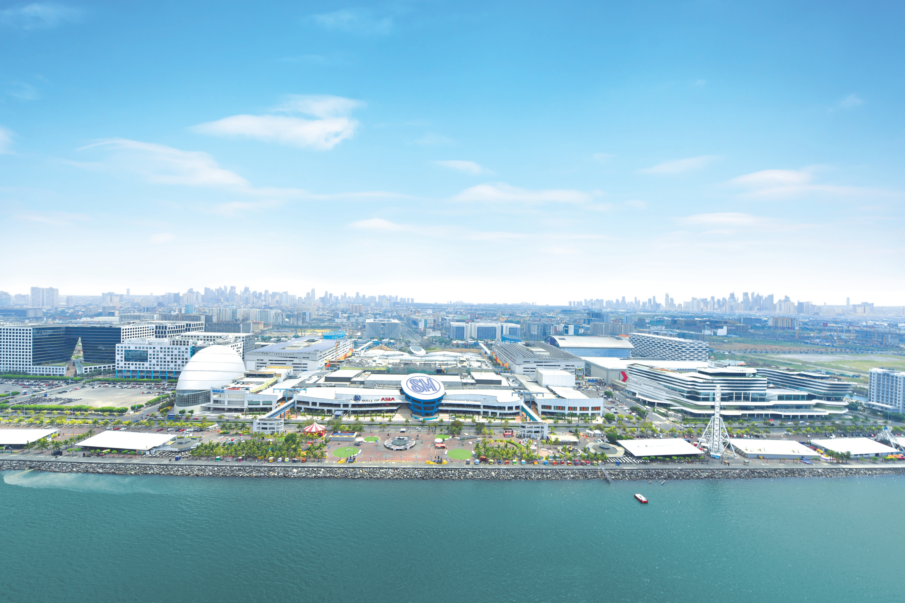
Q&A
23

Slide 24
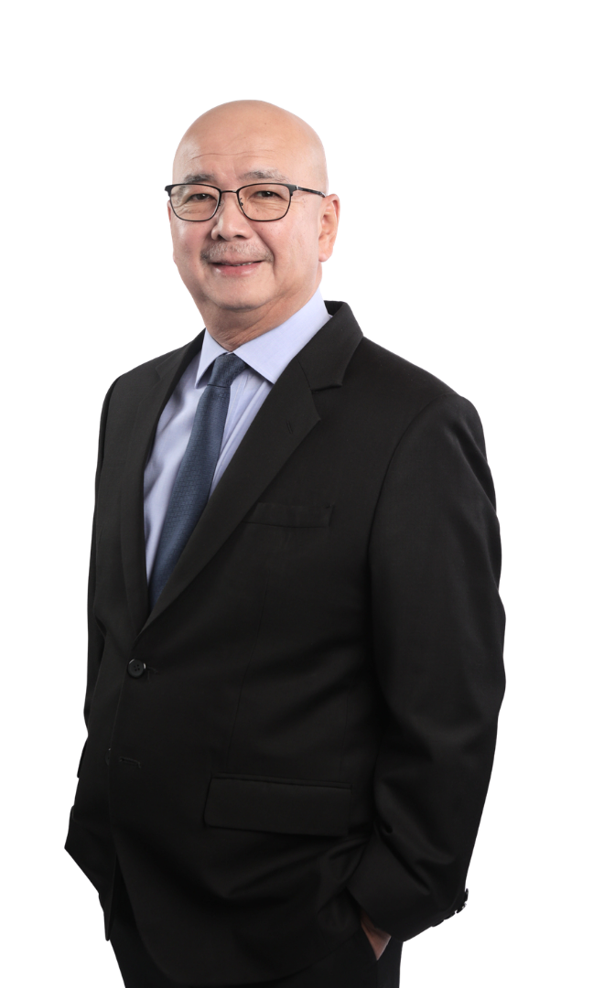

CLOSING REMARKS
CLOSING REMARKS
JEFFREY C. LIM
JEFFREY C. LIM
President
President
Replace JCL photo
23

Slide 25
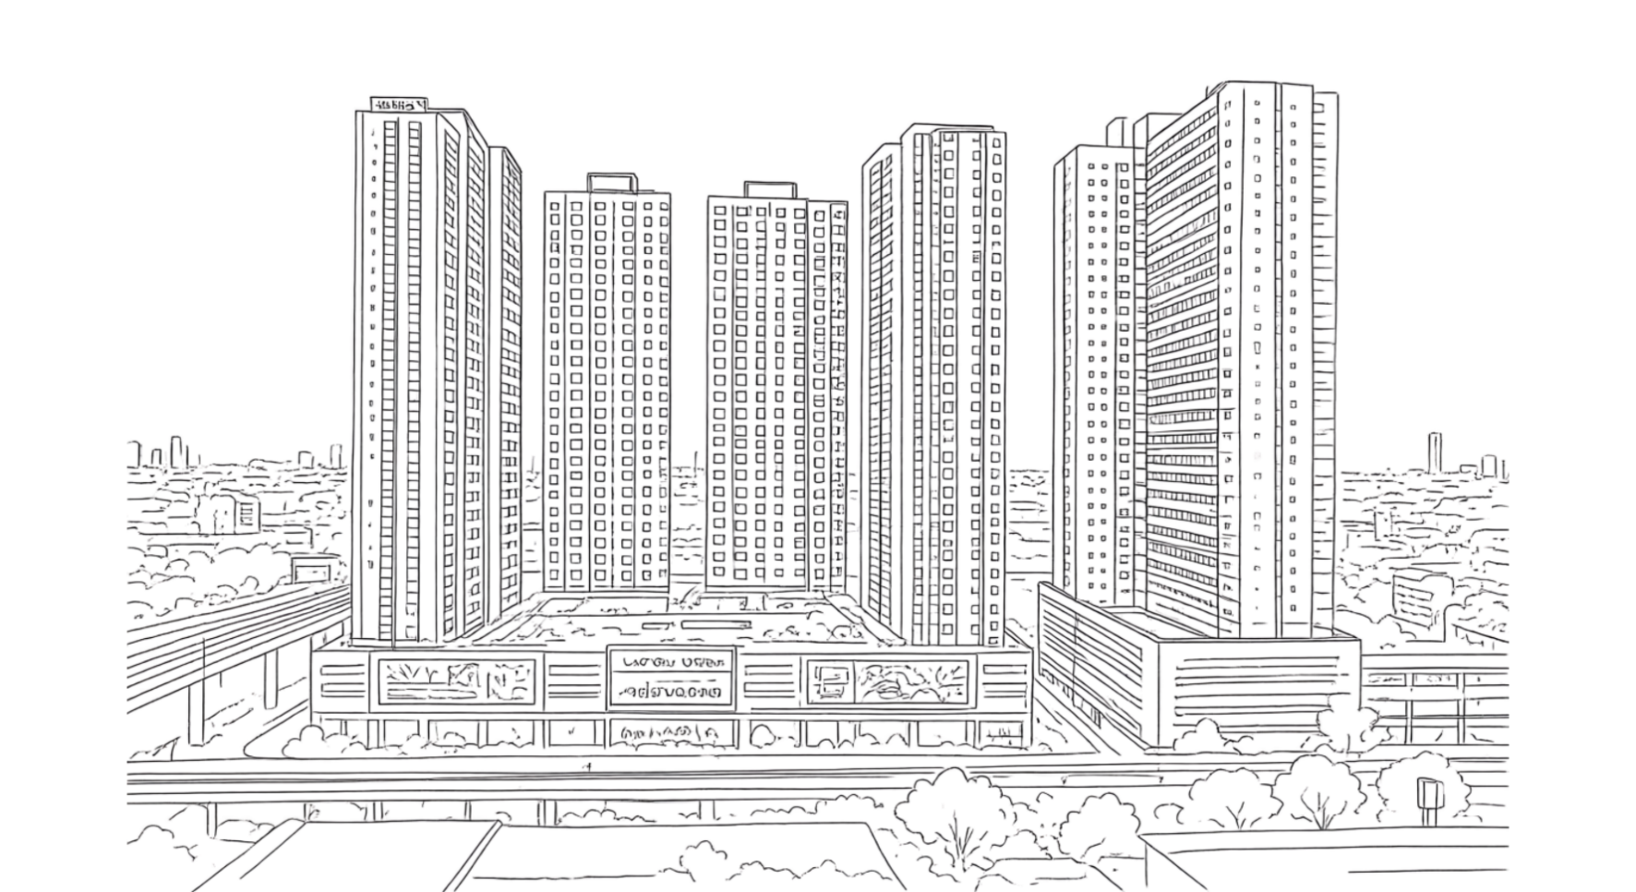
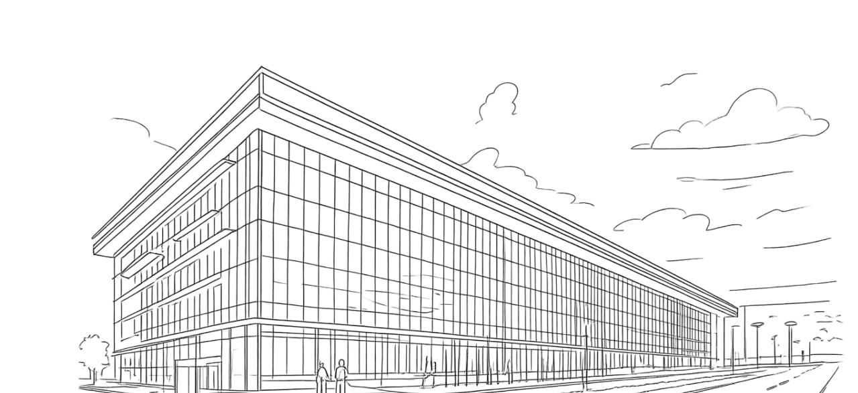
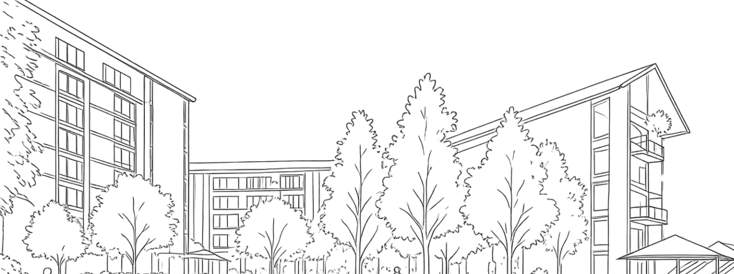
APPENDIX
FINANCIAL STATEMENTS
OTHER BUSINESS UPDATES
ESG HIGHLIGHTS
26
29
31
25

Slide 26
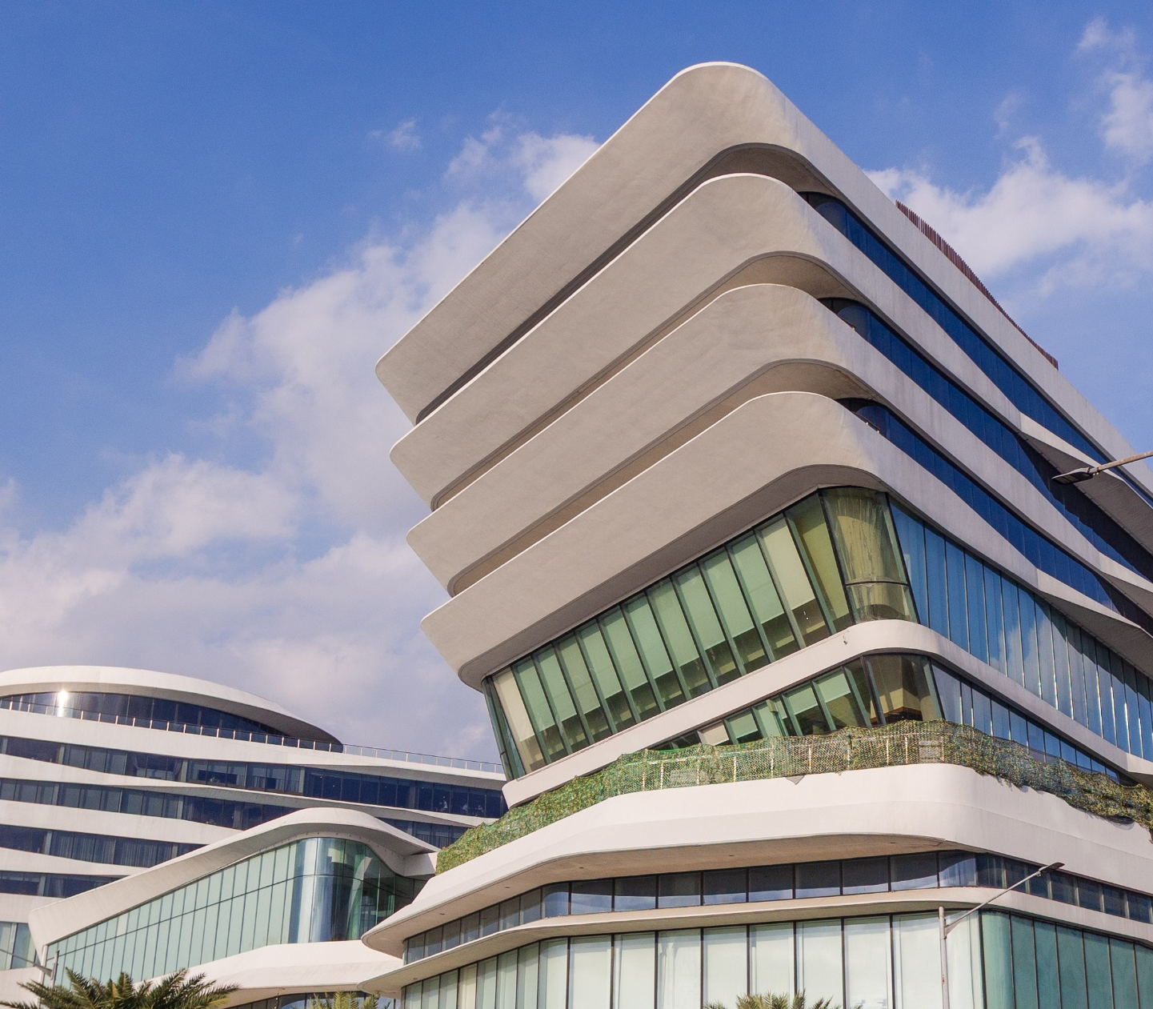
INCOME STATEMENT
Condensed, Unaudited
In Php mn, except EPS | 1Q 2026 | 1Q 2025
Revenues | 33,279 | 32,773
Cost and Expenses | 16,552 | 16,095
Operating Income | 16,727 | 16,679
Other Charges | -2,347 | -2,299
Income Before Tax | 14,380 | 14,380
Provision for Income Tax | 2,513 | 2,516
Net Income | 11,867 | 11,864
Net Income Attributable to Parent | 11,661 | 11,653
EPS – Basic/Diluted | 0.41 | 0.40
4
26
9

Slide 27
BALANCE SHEET
Condensed, Unaudited
ASSETS (in Php mn) | 1Q 2026 | FY2025
Cash & Cash Equivalents | 35,410 | 27,645
Equity instruments at FVOCI | 17,033 | 19,008
Receivables and Contract Assets | 88,038 | 86,190
Real Estate Inventories | 75,347 | 74,108
Investment Properties | 679,276 | 665,641
Other Assets | 215,776 | 221,287
Total Assets | 1,110,880 | 1,093,879
LIABILITIES & EQUITY (in Php mn) | 1Q 2026 | FY2025
Loans Payable and Current Portion of Long-term debt | 83,123 | 99,295
Accounts Payable & Other Liabilities | 206,443 | 202,046
Long-term debt - net of current portion | 343,001 | 323,460
Total Liabilities | 632,567 | 624,800
Total Equity | 478,313 | 469,079
Total Equity Attributable to Parent | 474,585 | 465,558
4
27
9

Slide 28
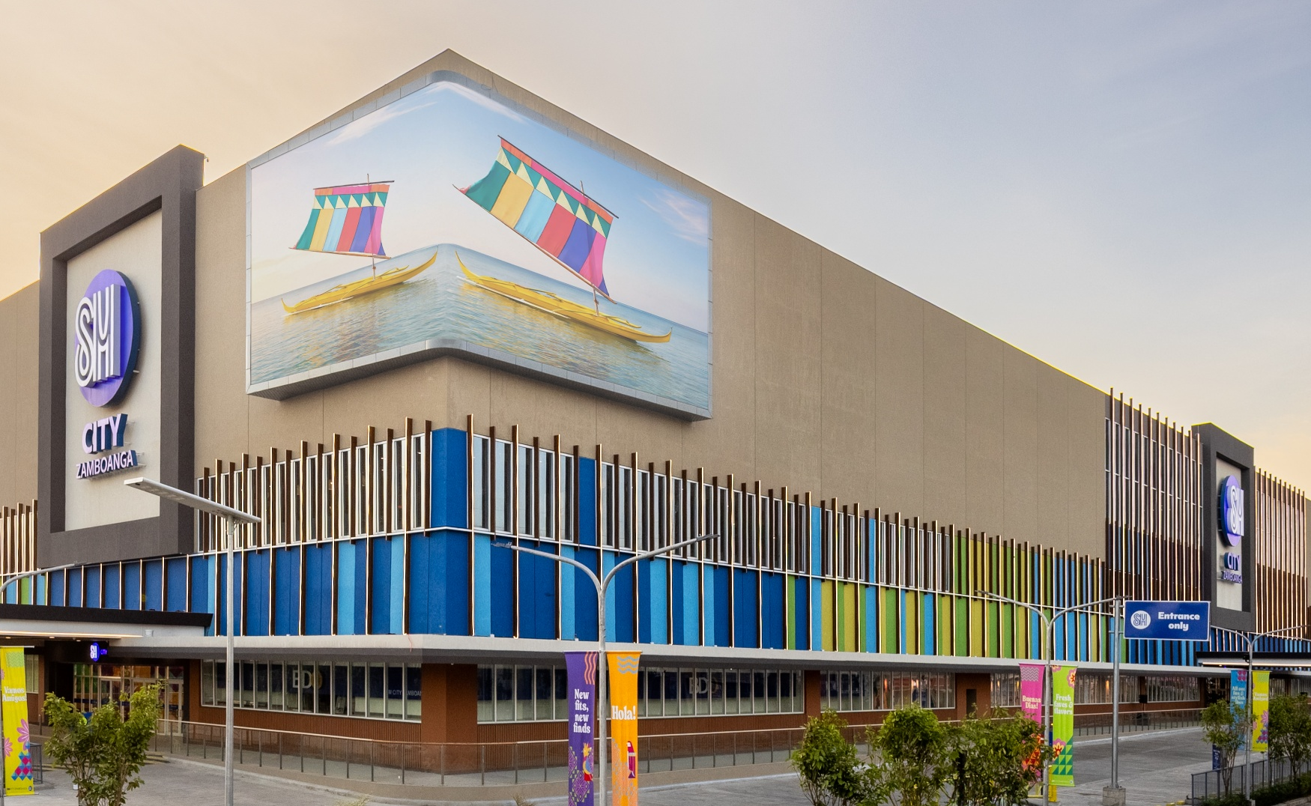
CASH FLOW STATEMENT
Condensed, Unaudited
In Php mn | 1Q 2026 | 1Q 2025
Net cash from operating activities | 19,851 | 17,753
Net cash used in investing activities | -11,265 | -16,296
Net cash from financing activities | -843 | 9,623
Currency Translation Impact | 21 | -4
Cash and cash equivalents at end of period | 35,410 | 42,322
4
28
9

Slide 29
CAPEX AND TREND BREAKDOWN
In Php bn | 2022 | 2023 | 2024 | 2025 | 1Q 2025 | 1Q 2026 | YoY
Malls | 22.91 | 36.55 | 36.63 | 32.66 | 8.26 | 6.65 | -19%
Residences | 36.75 | 25.49 | 23.14 | 16.93 | 2.65 | 5.39 | 104%
Commercial and Integrated Commercial Development (formerly Coastal Dev’t) | 9.84 | 18.57 | 19.55 | 30.01 | 5.89 | 2.55 | -57%
Hotels and Convention Centers | 1.11 | 1.78 | 1.94 | 2.27 | 0.26 | 0.88 | 233%
Total | 70.61 | 82.38 | 81.25 | 81.87 | 17.06 | 15.47 | -9%
*Excludes capitalized interest
PASAY 360 | 9.00 | 17.68 | 19.46 | 28.36 | 5.55 | 2.03 | -63%
Strategic Expansion (2022-1Q2026) | 331.58
4
29
9

Slide 30
LANDBANK
Geographically diverse land bank in key growth areas, suited for mixed-use development. Strategic acquisitions to support expansion and portfolio growth.
4,430
BY
BUSINESS
UNIT
BY
LOCATION
HECTARES
4
30
9

Slide 31
SHARE BUYBACK PROGRAM
PROGRAM DETAILS
Authorization Date | December 09, 2024
Total Authorized Amount | P5 billion - P10 billion
UTILIZATION RATE VS.
AUTHORIZED CAP (P10B)
EXCECUTION SUMMARY
Execution Period (Start–End Dates) | January - March 2026
Total Shares Repurchased | 84,343,200
Total Amount Spent | Php1,736,389,342
Price Range of Buybacks | Php18.96 to Php22.85
Average Purchase Price | Php20.59
% of Outstanding Shares Retired | 0.29%
29.8%
as of end 1Q 2026
17.4%
1Q 2026
alone
4
31
9

Slide 32
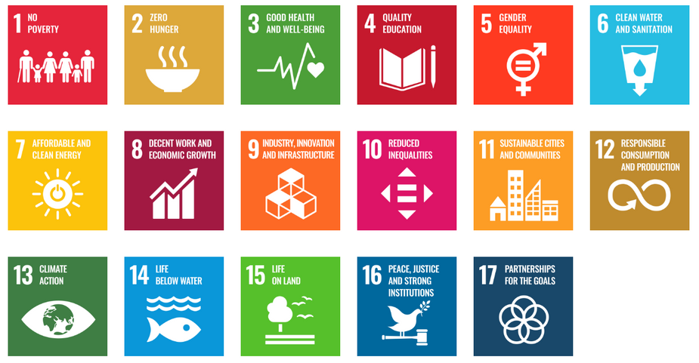
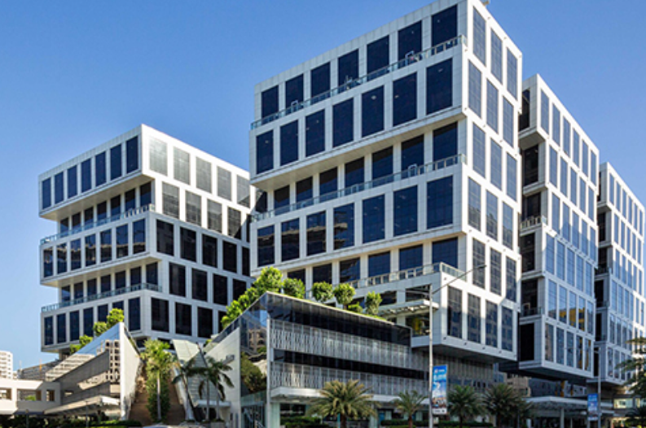
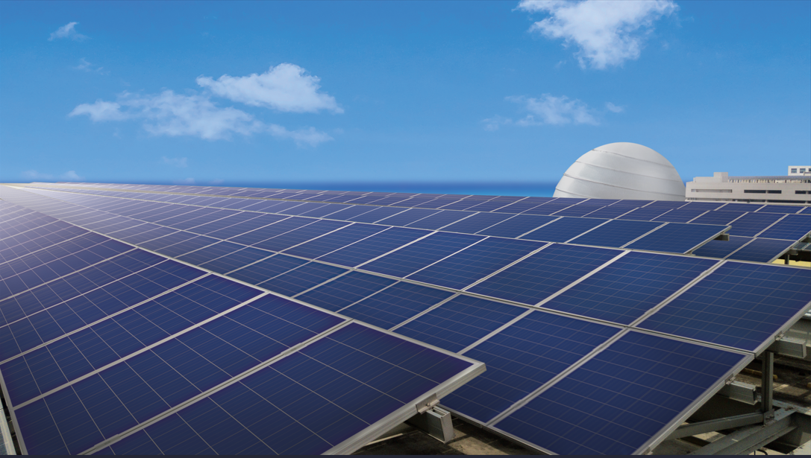
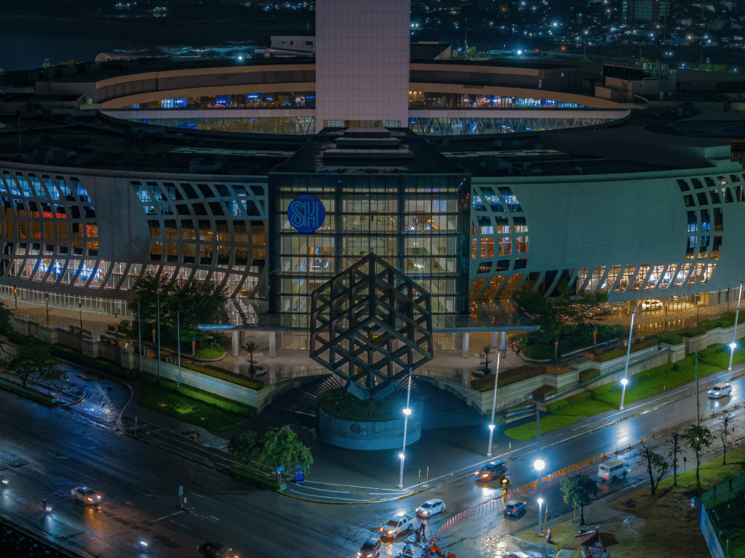

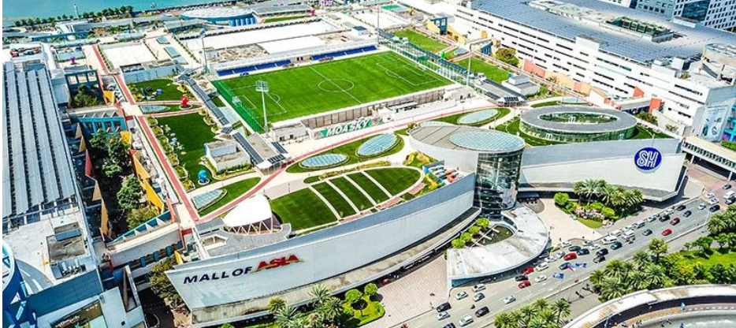
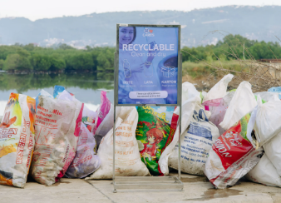
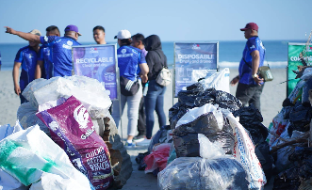

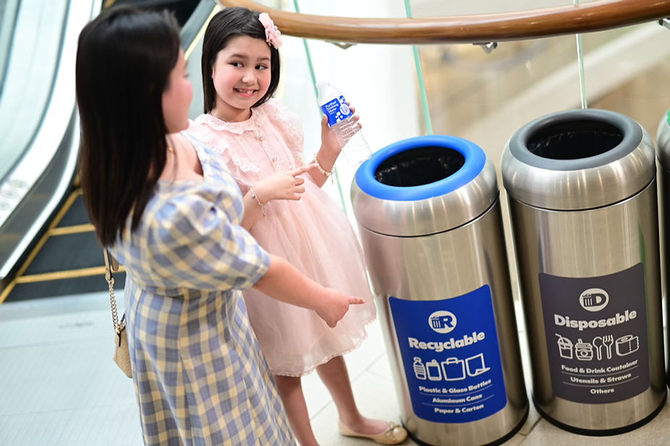
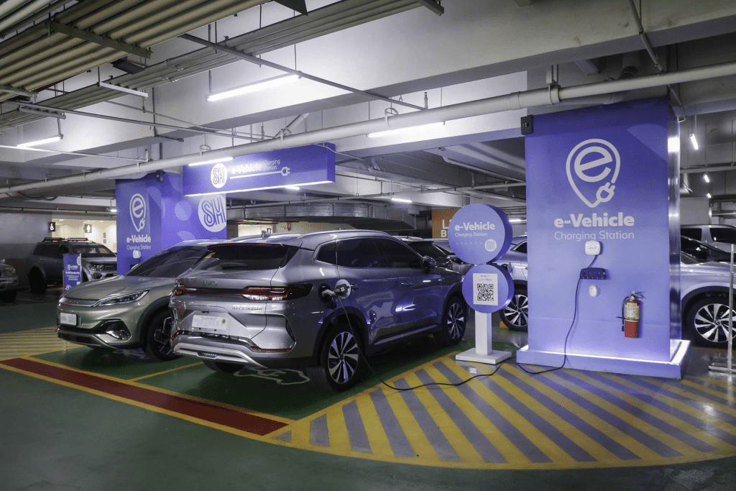
ENVIRONMENTAL
SM Prime continues to lead the way in sustainable property development, delivering low-carbon office spaces and climate-smart retail environments through energy efficiency initiatives, on-site renewable solutions and strategic long-term partnerships.
Water Recycling
Sustainable Power
Energy Savings
SM Prime sources more than 60% of its operational power from renewables.
SM Prime observed the global Earth Hour across its properties, with 6,079 KWh record environmental value.
SM Prime recycled 6.7 million cubic meters of water in 2025.
SM Offices recycled more than 185,000 cubic meters of water.
Target reached: 116MWp solar capacity in 69 properties
In celebration of World Water Day, over 3,500 volunteers participated in Coastal Cleanup activities across 7 SM malls across 6 locations.
Liza B. Silerio received the Woman in Water Leadership Award
246 tons of plastic waste diverted – 56% diversion rate
More than 160 EV charging stations across SM Prime properties
Disposable, Compostable—everyday segregation has been simple and doable
4
32
9

Slide 33
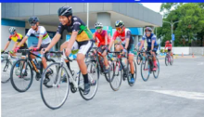
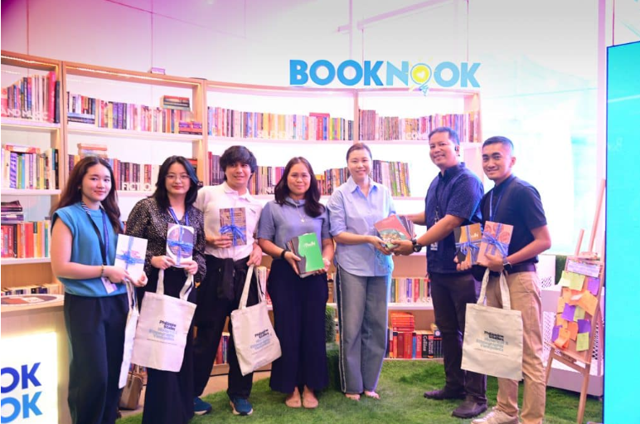
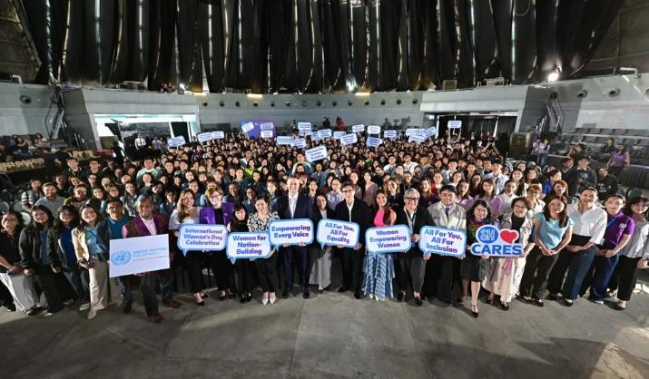
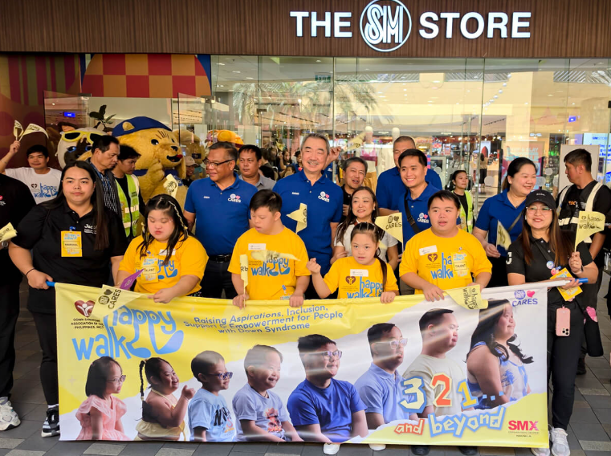
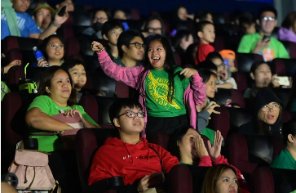
SOCIAL
Bike-inclusive SM
Book Nook Donation Drive 2026
Accelerated push for mobility earns SM a record-breaking 36 recognitions at the DOTr Mobility Awards for promoting safe, accessible, and sustainable transport across communities.
Nearly 100 peer-reviewed research journals were donated by Ateneo de Manila University to SM Book Nook, enriching community learning spaces.
Women’s Month 2026
SM Happy Walk 2026
Month-long initiative by SM Cares brought together youth leaders and partners to to advance gender equality, maternal health and social awareness through forums, campaigns, and community programs.
Over 10,500 participants gathered nationwide for SM Cares’ Happy Walk 2026, celebrating inclusion and raising awareness for individuals with Down syndrome
“Autism-OK Mall”
The country’s first SM Sensory Lab launched and sensory-friendly initiatives like “Lights Up, Sounds Down” expanded to enhance accessibility, awareness and everyday experiences for individuals on the autism spectrum and their families.
4
33
9

Slide 34

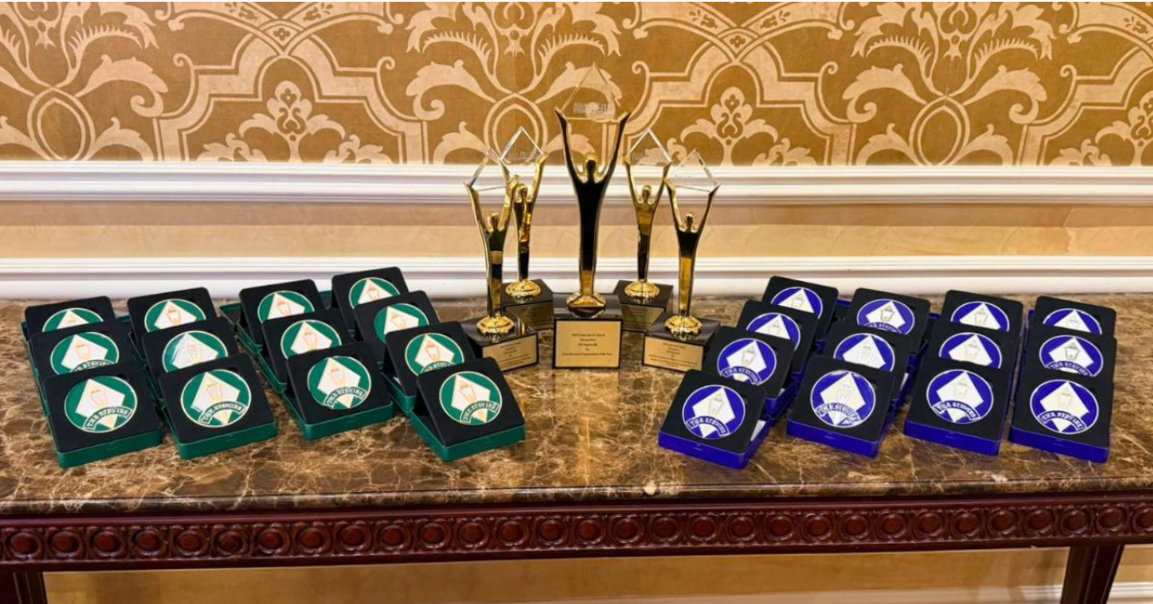
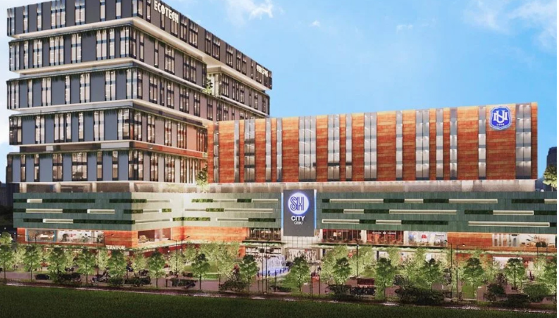
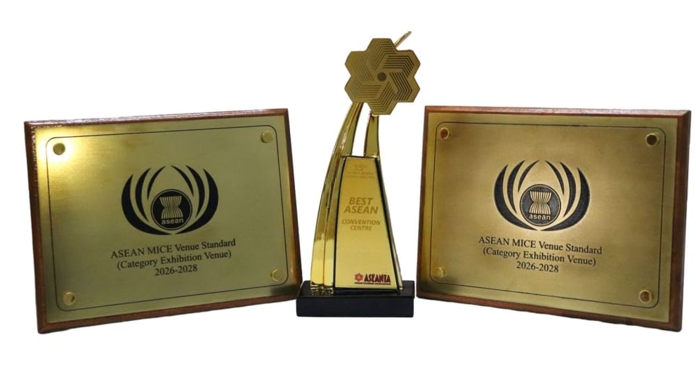
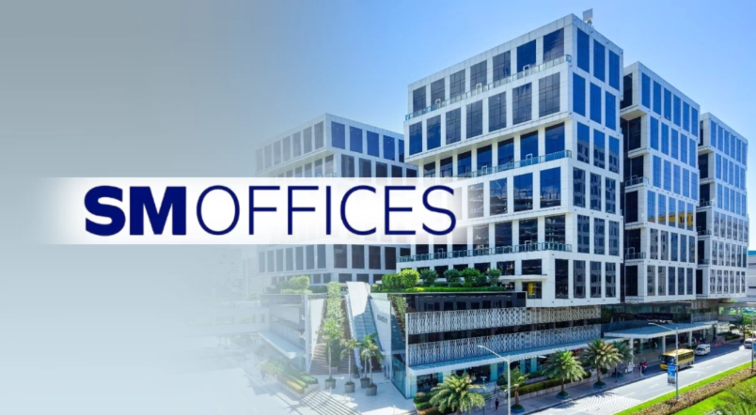
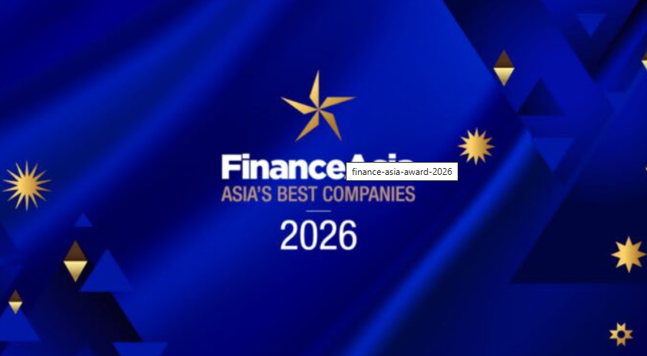


GOVERNANCE
2026 Asia Pacific Stevie Awards
SM Offices Adds 60,000 sqm in Cebu
SM Supermalls was named Organization of the Year, earning multiple distinctions across categories such as innovation in community events, purpose-driven marketing, diversity & inclusion, and corporate communications.
Over 60,000 sqm of leasable space will be added in Cebu by Q4 2026, capitalizing on strong regional demand from corporate and BPO tenants and reinforcing Cebu’s position as a key growth hub outside Metro Manila.
Asean Tourism Forum
SM Offices Accelerates Green Push
SMX Convention Center was named Best ASEAN Convention Centre, with additional ASEAN MICE Venue recognitions across its venues, reinforcing its leadership in regional events, exhibitions, and convention excellence.
SM Offices accelerates its sustainability push through green-certified buildings, increased renewable energy use, and energy-efficient systems—supporting corporate tenants in achieving their climate and ESG goals.
2026 FinanceAsia Asia’s Best Companies
Cre­at­ing Brighter Futures Today at SM Offices
Four SM Group companies—SM Investments, SM Prime, SM Retail, and BDO—earned eight awards, including ESG, management, and industry leadership recognitions, based on investor and analyst assessments.
SM Offices and National University convened 3,600 students at SMX Convention Center, connecting academic talent with industry opportunities through career talks, employer engagement, and direct recruitment.
4
34
9

Slide 35
Thank you for attending.
INVESTOR RELATIONS
T: (02) 8 862-7942
E: INFO@SMPRIME.COM
WWW.SMPRIME.COM

